Slide 1

C♯ this._course.Dispose();
Rasmus Lystrøm
Associate Professor
ITU

Slide 2

Agenda
Docs
Automatic package updates
CRUD using Blazor
Using Azure Storage for Files
Integration Testing
App Roles and AAD auth
DevOps
Infrastructure as Code
Continuous Deployment
A note on the exam
Questions and Feedback
This Photo by Unknown Author is licensed under CC BY-NC-ND

Slide 3
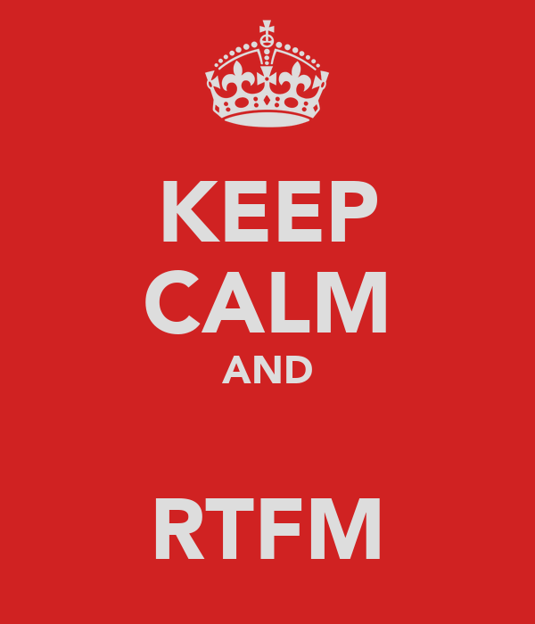
When in doubt; read the docs!
Source: http://keepcalm-o-matic.co.uk/p/keep-calm-and-rtfm-123

Slide 4
Keeping your code up to date
ALWAYS upgrade to the latest version of your framework.
ALWAYS upgrade to the latest version of your dependencies – NuGet, npm, Maven, etc.
Use Dependabot.

Slide 5
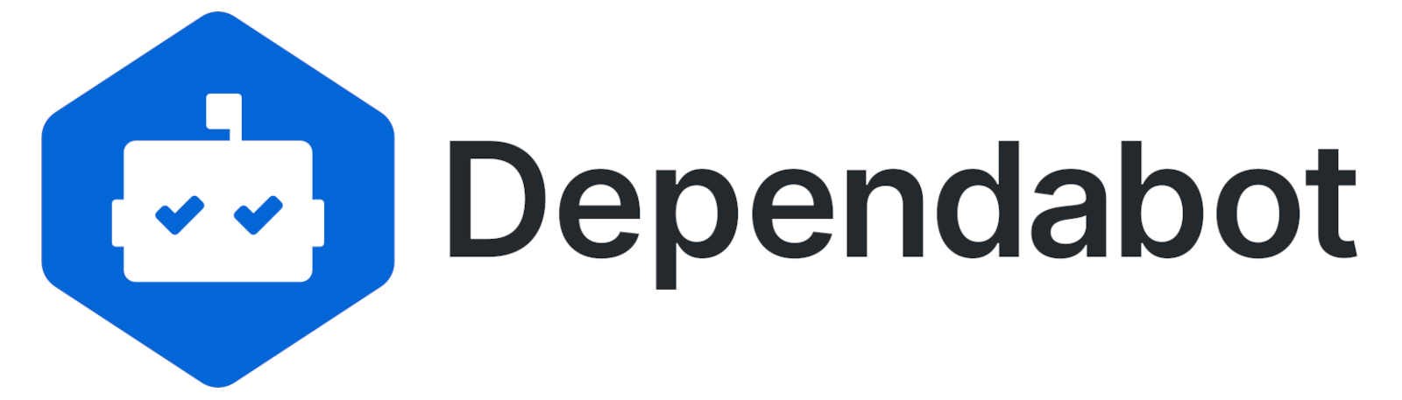
Automatic Package Upgrades - Demo
This Photo by Unknown Author is licensed under CC BY-NC

Slide 6
.github/workflows/dependabot.yml
---
version: 2
updates:
- package-ecosystem: nuget
directory: /
schedule:
interval: daily

Slide 7
Blazor CRUD and Azure Storage
Demo

Slide 8
App Roles and AAD auth
Demo

Slide 9
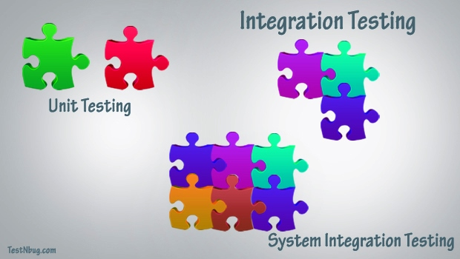
This Photo by Unknown Author is licensed under CC BY-SA

Slide 10
Integration Testing
Demo

Slide 11

This Photo by Unknown Author is licensed under CC BY-SA-NC

Slide 12
DevOps
DevOps is a set of practices that automates the processes between software development and IT teams, in order that they can build, test, and release software faster and more reliably. The concept of DevOps is founded on building a culture of collaboration between teams that historically functioned in relative siloes.
Source: https://www.atlassian.com/devops

Slide 13
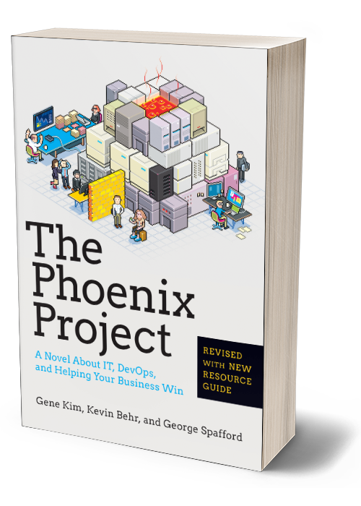

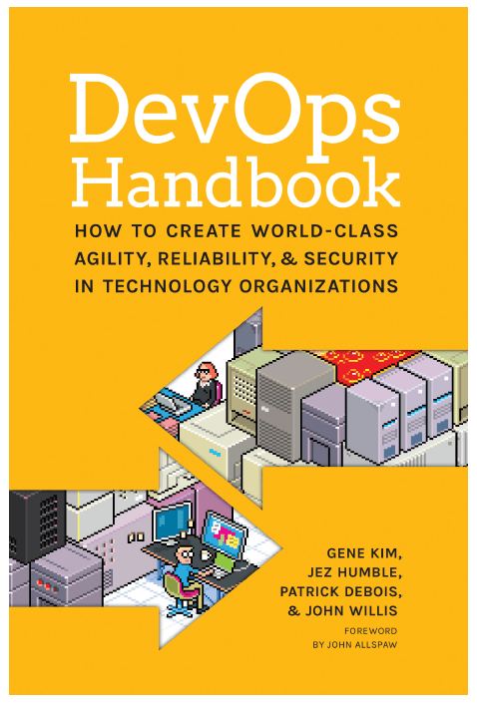
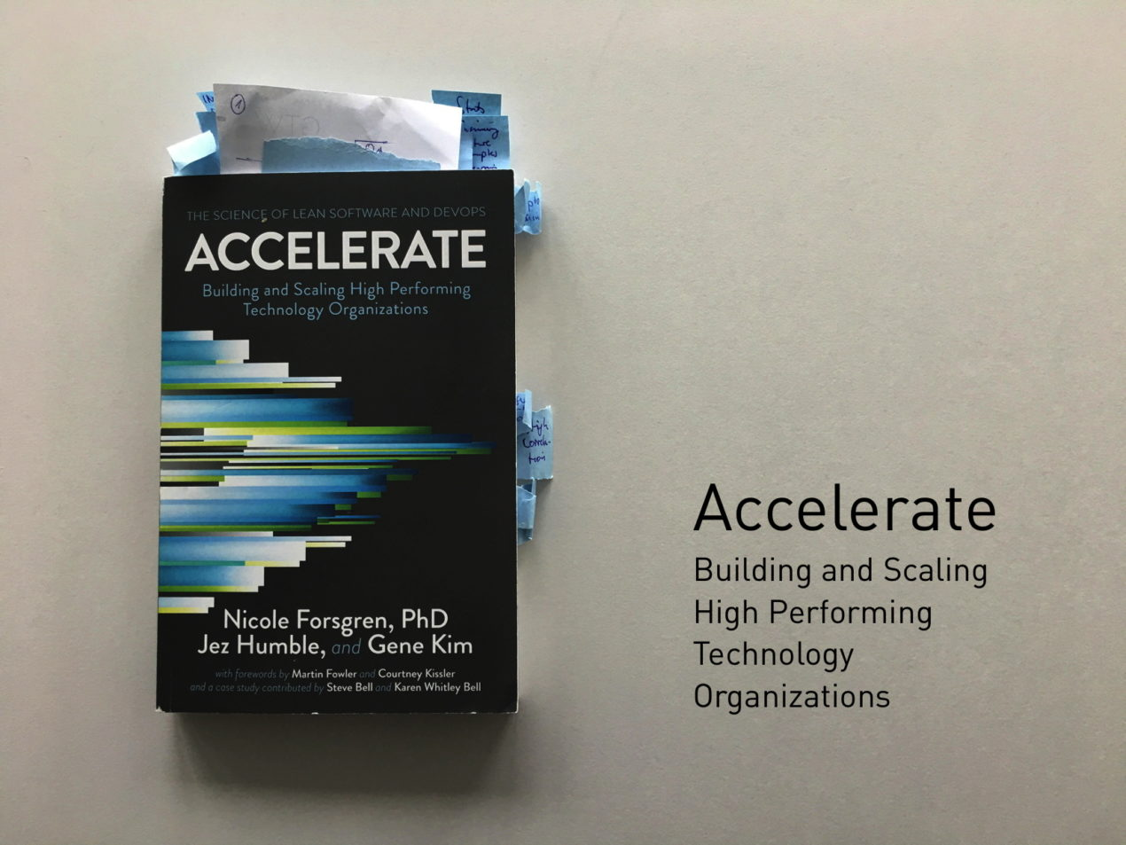
Books

Slide 14
Continuous Delivery

Slide 15
Continuous Delivery
Continuous delivery is an approach where teams release quality products frequently and predictably from source code repository to production in an automated fashion.

Slide 16
Continuous Deployment

Slide 17
Infrastructure as Code

Slide 18
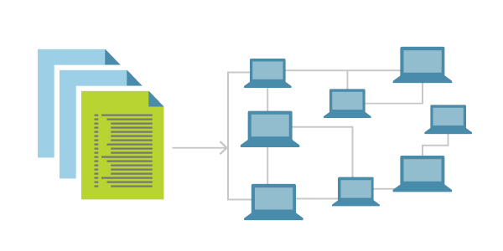
Infrastructure as Code
Infrastructure as Code (IaC) is the management of infrastructure (networks, virtual machines, load balancers, and connection topology) in a descriptive model, using the same versioning as DevOps team uses for source code.
Idempotent
IaC is a key DevOps practice and is used in conjunction with CD
Source: https://docs.microsoft.com/en-us/azure/devops/learn/what-is-infrastructure-as-code

Slide 19
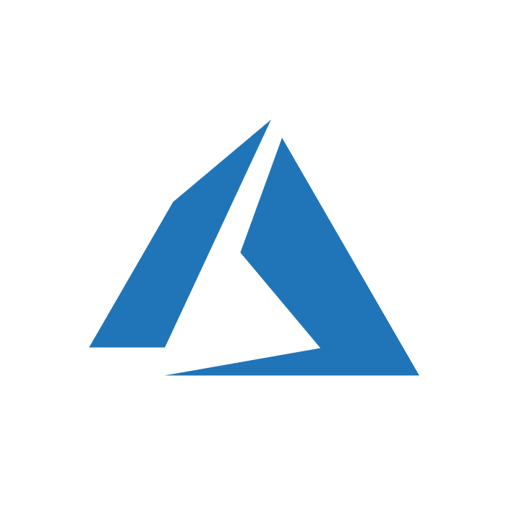
Infrastructure as Code Tools for Microsoft Azure
Azure PowerShell
Azure CLI
Bicep
ARM Templates
Terraform

Slide 20
Continuous Delivery and Deployment Infrastructure as Code
Demo

Slide 21
A note on the exam

Slide 22

Steps
Read through the whole thing – cover to cover
Read through the whole thing – cover to cover AGAIN
Choose an order:
Solve the easiest
The most points
The ones you know you can do

Slide 23
Questions and Feedback

Slide 24

Thank You!

